Slide 1

Mastering GraphQL
Ali Haider

Slide 2
Contents:
Definition
Why We Need GraphQL
Best Features
REST vs GraphQL
Operations of the GraphQL
Caching in GraphQL
Advantages vs Disadvantages
Best Writing Practices for GraphQL
Conclusion

Slide 3
Introduction to GraphQL
“GraphQL is a query language for APIs that allows clients to request exactly the data they need, avoiding over-fetching and under-fetching. It uses a clear schema to ensure accurate and efficient data retrieval.”

Slide 4

Why we need GraphQL?

Slide 5
Reasons:
Precise Data Requests:
GraphQL allows clients to request exactly the data they need in one go, avoiding problems of over-fetching or under-fetching that can occur with traditional APIs.
Strongly Typed Schema:
It uses a clear and detailed schema to define what data is available and how to access it, which helps prevent errors and makes development more efficient.
Efficient Data Handling:
GraphQL enables fetching multiple resources and nested data in a single request, simplifying client-side logic and reducing the number of network requests needed.

Slide 6
Features of the GraphQL
Customizable Responses
Pagination
Sorting
Filtering
Efficiency in Data Fetching:
Single Endpoint Advantage:

Slide 7
GRAPHQL VS REST
GraphQL is a query language
Single Endpoint
Client driven architecture
No automatic caching available on API versioning
JSON representation only
Rest is an architectural pattern
Multiple Endpoints
Server driven architecture
Uses caching automatically and uses multiple API versioning
Supports multiple data formats

Slide 8

Key Differences
Data Handling
REST API follows a stateless server-client model where data is typically fetched from dedicated endpoints. In contrast, GraphQL enables clients to request specific data structures in a single query, enhancing efficiency and reducing over-fetching.
Response Structure
REST API responses are fixed to what the server provides, leading to potential over-fetching or under-fetching of data. GraphQL, on the other hand, allows clients to define the response structure, obtaining exactly the data needed.
Performance Flexibility
REST API performance can be impacted by multiple endpoints requests. GraphQL optimizes performance by fetching all required data in a single request, reducing network overhead and improving speed.

Slide 9

Performance Metrics
60%
40%
REST API Performance
GraphQL Performance
REST API traditionally leads to higher network overhead due to multiple endpoint requests, impacting response times. However, caching mechanisms can aid in improving performance.
GraphQL's ability to fetch precise data in a single request enhances performance by reducing network latency. Its efficient query mechanism can lead to faster response times.

Slide 10
Operations of GraphQL
Query Types
Mutation Types
The Query type in GraphQL allows clients to ask for specific data from the server, defining what data can be requested and how it is structured.
The Mutation type in GraphQL allows clients to modify data on the server, defining operations for creating, updating, or deleting data.
Subscription Type
The Subscription type in GraphQL enables clients to receive real-time updates from the server whenever specified data changes.

Slide 11
Operations of GraphQL
Fragmentation:
Introspection:
Fragmentation in GraphQL allows for the reuse of common query parts across multiple queries to avoid redundancy.
Fragments simplify large queries, making them more readable.
They facilitate easier updates to queries by changing the fragment.
Introspection in GraphQL provides a mechanism for querying the schema itself, enabling tools to understand and interact with the API's structure.
Introspection queries let you see the API's schema details.
They help you to understand the available types and fields.

Slide 12
Caching in GraphQL:
Automatic caching isn't supported for GraphQL APIs because the flexible queries make caching unpredictable.
Five methods to solve caching problem in GraphQL:
Server-Side Caching (Apollo Server, Data Loader, Redis)
Client-Side Caching (Apollo Client)
Cache Control Headers (Use HTTP headers)
Persisted Query (Use Query Storage)

Slide 13
Advantages of GraphQL
Reduced Over-fetching
By specifying the exact data requirements in queries, GraphQL eliminates over-fetching issues where unnecessary data is retrieved. This optimization improves network efficiency and application performance.
Efficient Data Retrieval
GraphQL allows clients to request only the specific data they need, reducing over-fetching and minimizing network transfer. This leads to faster and more efficient data retrieval processes.
Flexibility in Queries
With GraphQL, clients can define the structure of responses, enabling flexible querying based on application requirements. This dynamic approach enhances development flexibility and adaptability.

Slide 14
Disadvantages of GraphQL
Steep Learning Curve
GraphQL's advanced features and unique syntax can pose a challenge for beginners, requiring time and effort to grasp complex concepts such as schemas, resolvers, and type definitions.
Performance Concerns
In some cases, GraphQL queries may lead to inefficient data fetching or N+1 query problems if not optimized properly. Monitoring and optimizing queries are essential to prevent performance bottlenecks.
Error Handling Complexity
Handling errors in GraphQL can be intricate due to the decentralized nature of queries and mutations. Implementing robust error handling strategies is crucial for maintaining data integrity and application stability.
Photos provided by Unsplash

Slide 15
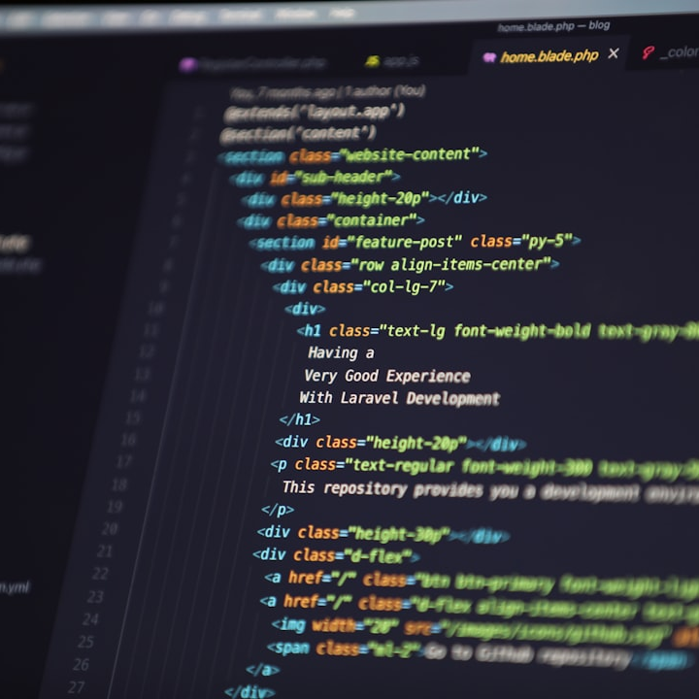
Best Writing Practices in GraphQL
Define Schema Carefully:
Create a well-structured and comprehensive schema to serve as the single source of truth.
Use Aliases and Fragments:
Optimize queries with aliases and fragments to reduce redundancy and improve readability.
Implement Proper Error Handling:
Ensure robust error handling for both client and server to enhance debugging and user experience.
Use Batching and Caching:
Utilize batching and caching mechanisms to optimize performance and reduce server load.
Secure Your Endpoint:
Apply authentication, authorization, and rate limiting to protect your GraphQL endpoint from abuse and unauthorized access.

Slide 16
Conclusion
Continued Exploration
Encourage further exploration and learning in GraphQL to unlock its full potential and stay updated on new developments and advancements in the GraphQL ecosystem for future projects and innovations.
Key Takeaways
Mastering GraphQL involves leveraging best writing practices, understanding the advantages and disadvantages, exploring different field types, and embracing real-time subscriptions for enhanced application functionality.
Embracing Best Practices
Adhering to best practices in GraphQL development leads to more efficient and maintainable codebases, improving collaboration, scalability, and performance in software projects.

Slide 17
Thank You…!

